Slide 1


Automaspec
AUTOMASPEC
From test results to living specifications
One workspace to link requirements to real tests and see live CI status by requirement
Roman Radchenko + Aliaksandr Samatyia |
Volha Kuzniatsova |
January 7, 2026

Slide 2
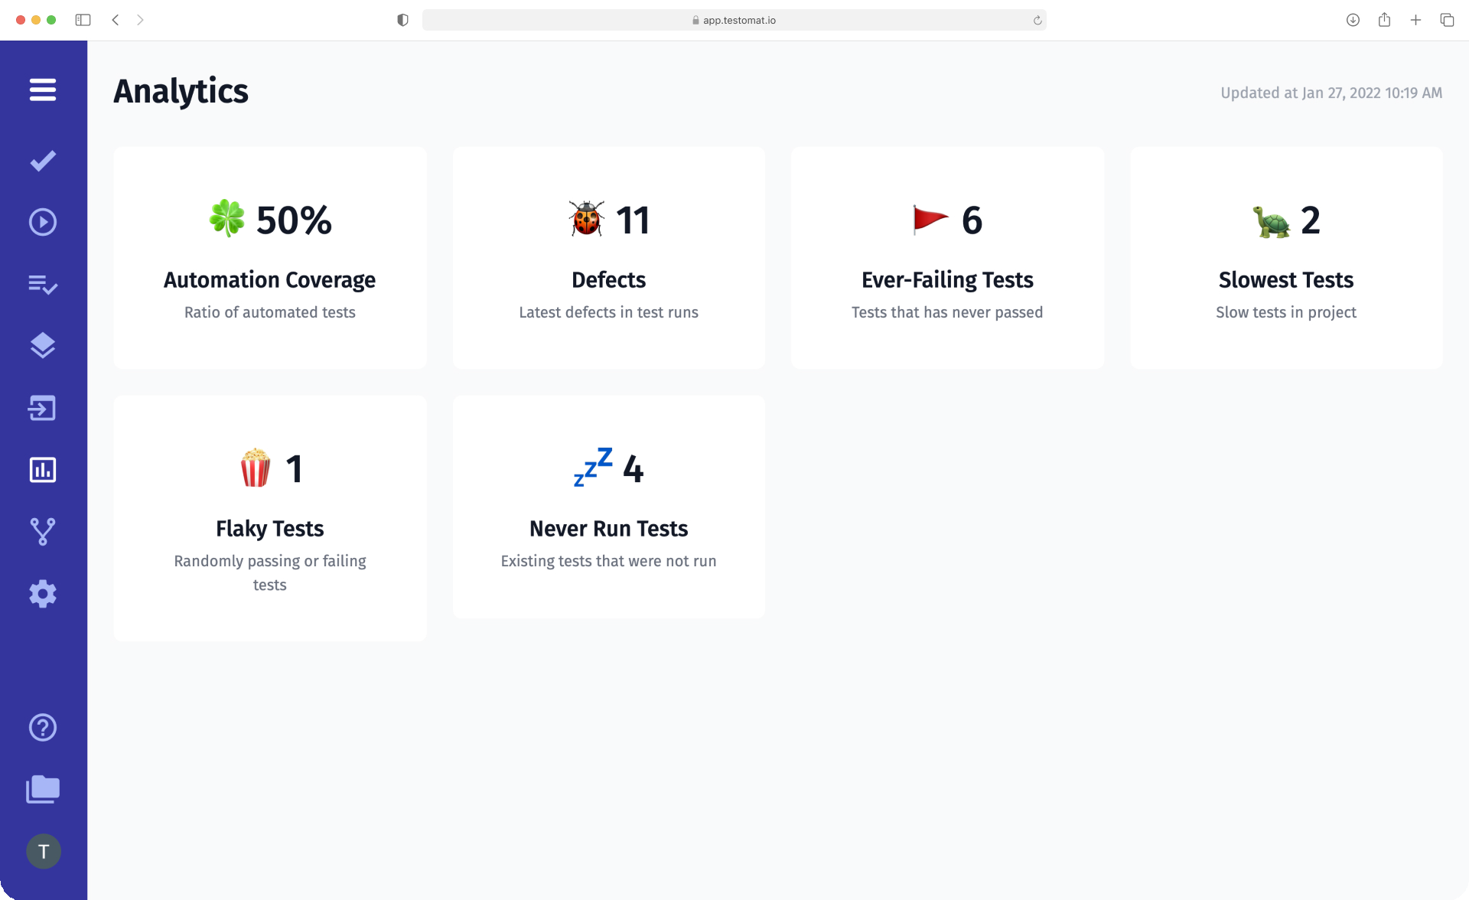
Why This Matters
THE PROBLEM
"You ship a feature, CI is green — and the PM asks: Are all requirements actually covered?"
Coverage is "a number", not evidence
Which tests prove requirement X?
Test results live in CI logs
Buried in logs, hard to find
Docs drift from reality
Updating links is manual & error-prone
AUTOMASPEC

Slide 3
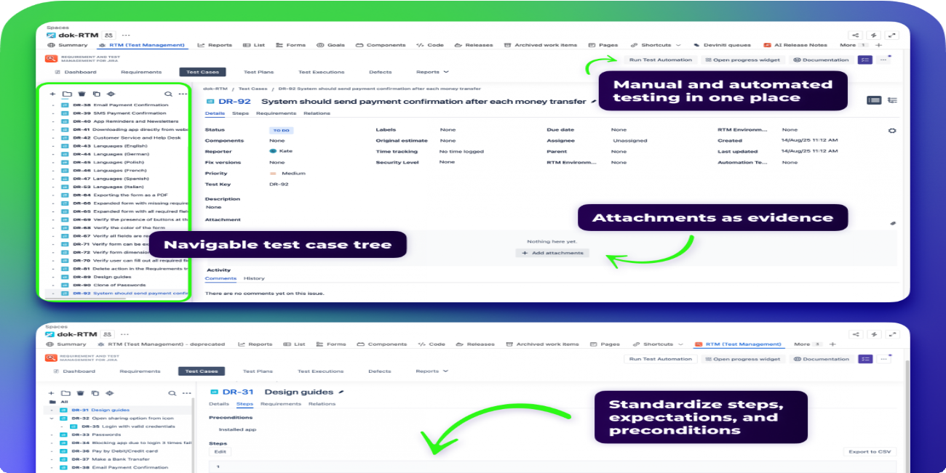
THE BIG IDEA
What We Built
Structured Workspace
Folders → Features → Requirements → Tests with aggregated status
Import Real Tests
Start from existing Vitest JSON report
CI-Driven Status
Pass/fail/pending by requirements
Visibility for Stakeholders
Analytics that answer "are we OK?" and "what's missing?"
Linking tests to requirements with live CI status
AUTOMASPEC

Slide 4
Team Responsibilities
AUTOMASPEC
WHY WE SPLIT ROLES
Roman Radchenko
Backend & Data Lead
Aliaksandr Samatyia
Frontend & UX Lead
Backend + DB
Schema, migrations, import/sync flows
Frontend
Dashboard UI and components
Analytics
Metrics and health overview
UX
Flows and onboarding experience
AI Assistant
Faster requirement drafting workflow
Integration
Demo flow and CI wiring
Quality
Unit + E2E tests
We split roles to move faster and play to strengths

Slide 5
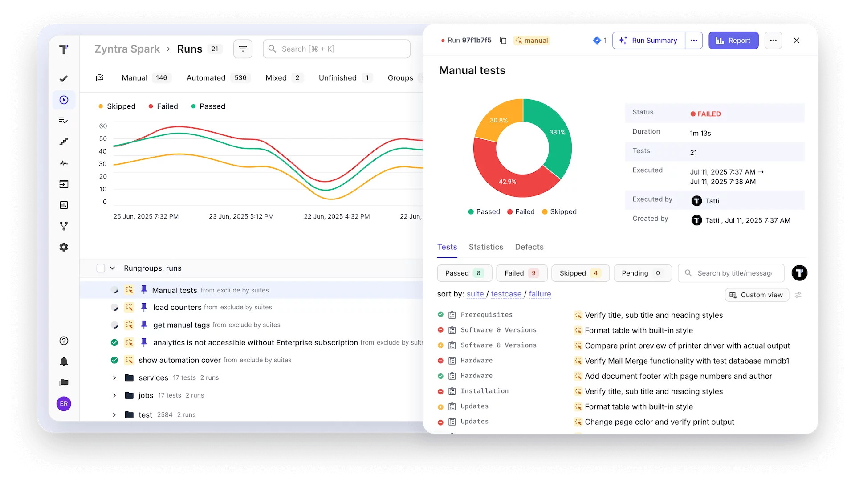
How It Works
LIVE DEMO
01
Generate & Import
Generate Vitest JSON report → Import into Automaspec
02
Explore & Verify
Real-time visibility into requirement coverage and CI status at a glance
Open a requirement → See exact verifying tests + latest CI status
AUTOMASPEC

Slide 6
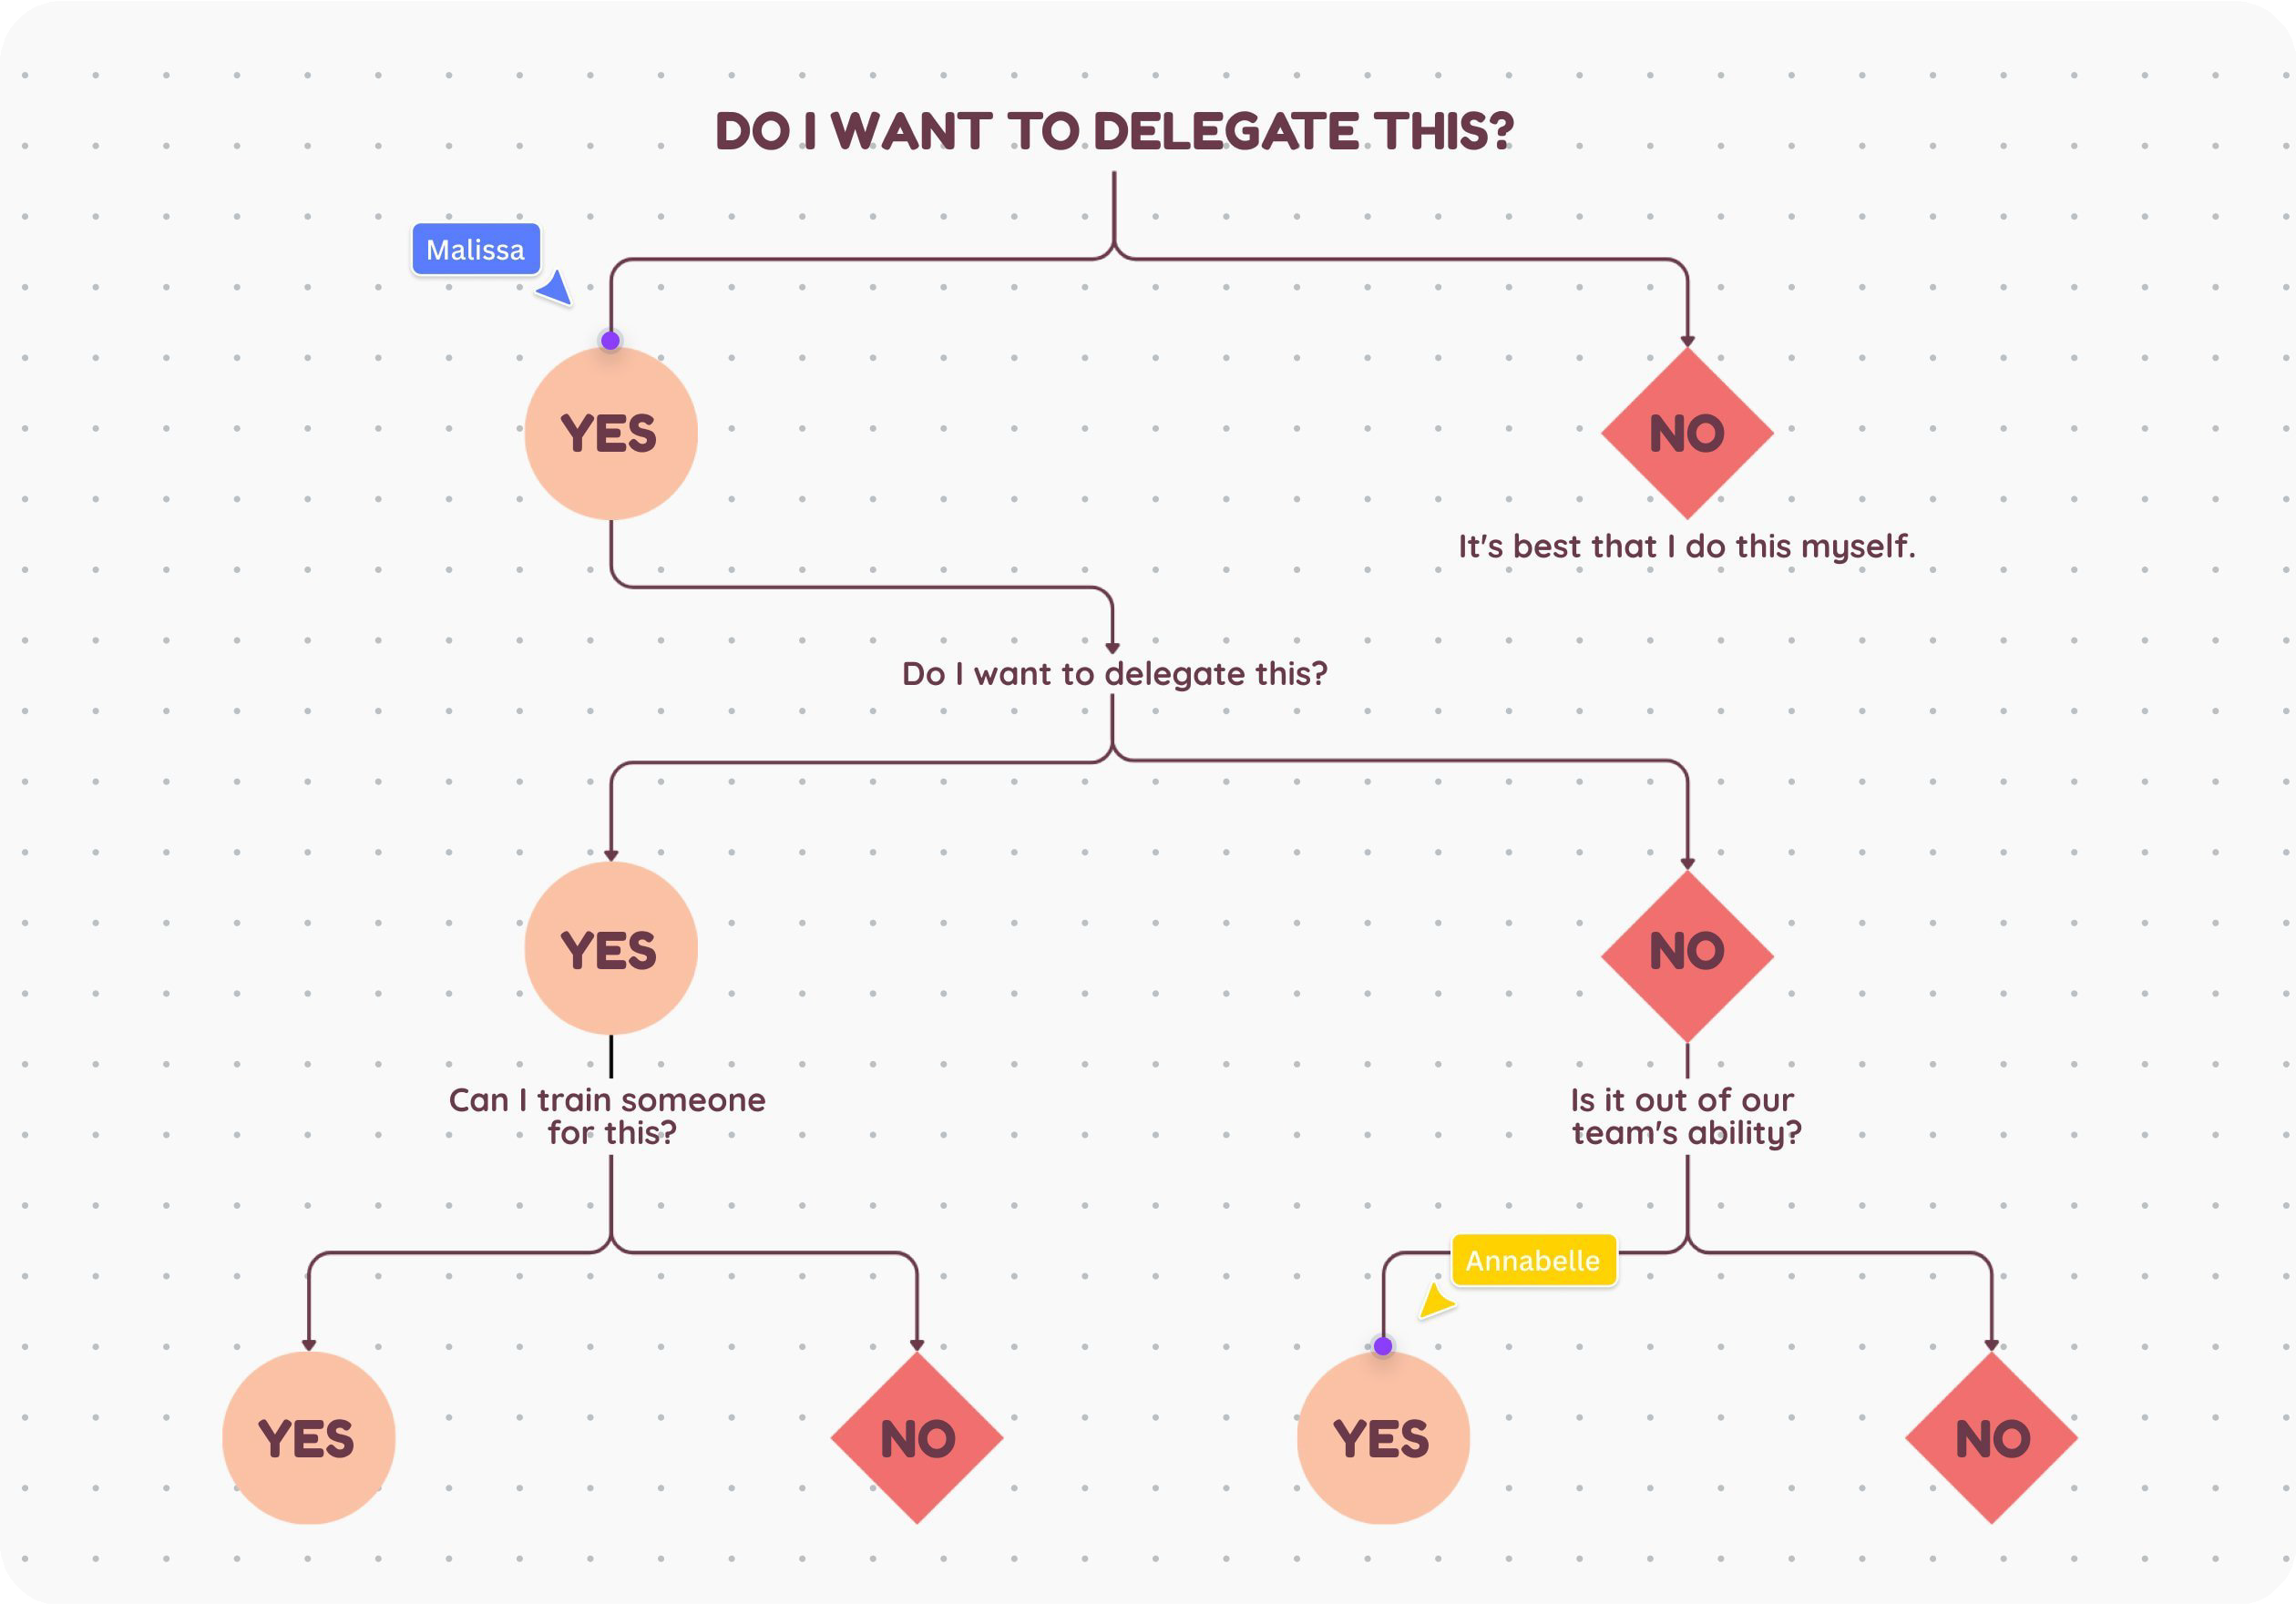
TECHNICAL CHALLENGE
Tree Structure
Level 1
Folders
Hierarchical model enables aggregated CI status from test level up to requirements
Level 2
Features
Level 3
Requirements
Level 4
Tests
AUTOMASPEC

Slide 7
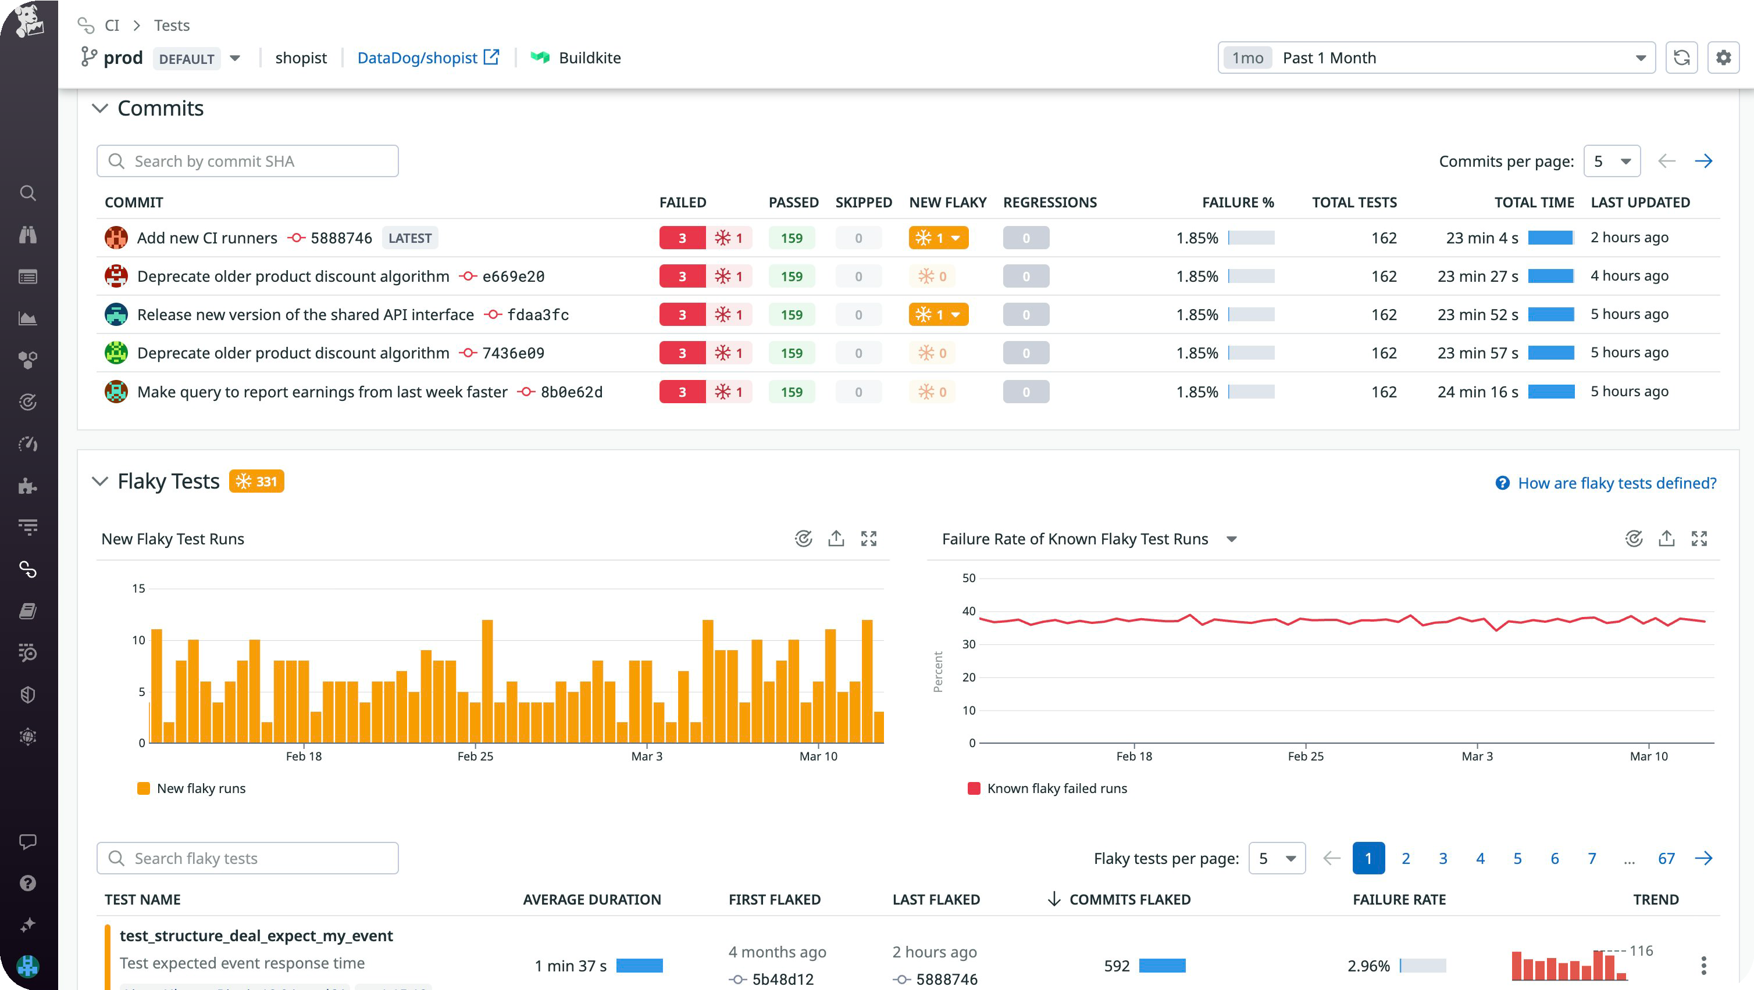
Dashboard
ANALYTICS
Coverage by Requirement
Pass / Fail / Pending status
87%
COVERAGE
142
TESTS
23
REQS
Are We OK?
Overall health score indicator
What's Missing?
Uncovered requirements list
AUTOMASPEC

Slide 8
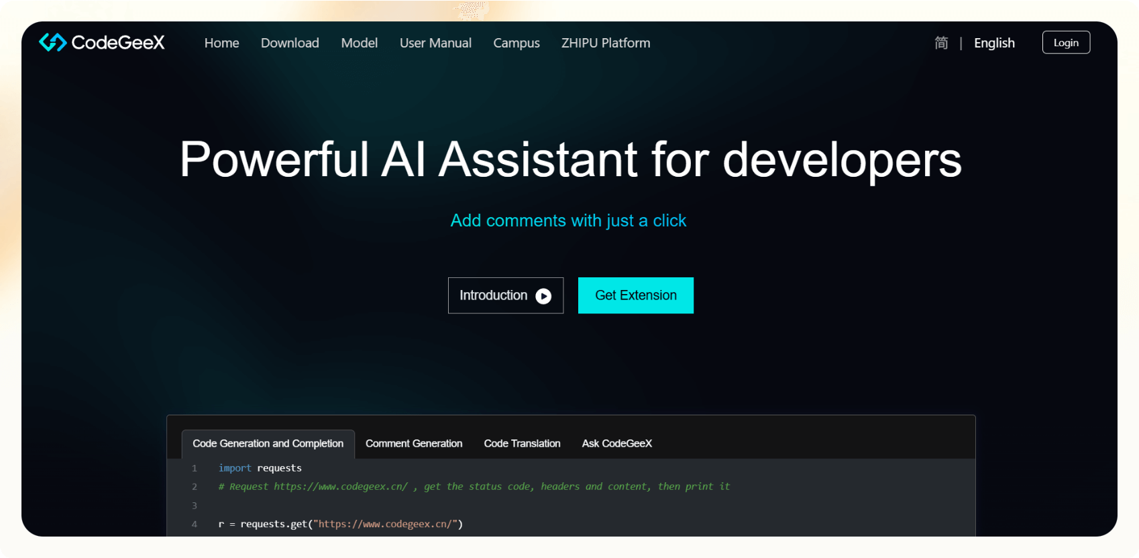
AI ASSISTANT
Your Spec Writing Partner
Transform Ideas to Specs
Turn rough ideas into clear, testable requirement drafts
Suggest Edge Cases
Identify missing edge cases and acceptance checks
Human-reviewed: AI speeds up writing, you own final spec
Navigation Help
Answer "what covers this requirement?" instantly
AUTOMASPEC

Slide 9
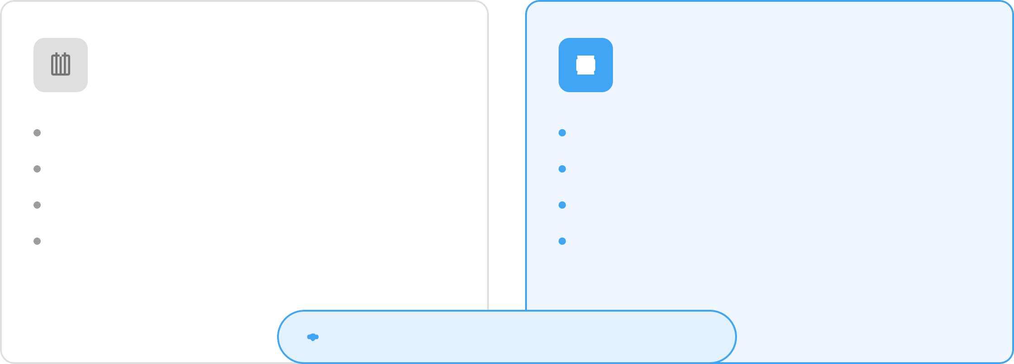
Automaspec vs Jira
COMPARISON
Jira
Automaspec
Planning & Roadmapping
Verification & Testing
Task Management
Requirement Coverage
Bug Tracking
CI Status by Requirement
Prioritization
Live Test Results
Automaspec complements Jira — it doesn't replace it
AUTOMASPEC

Slide 10
Roman Radchenko
MY CONTRIBUTION
Backend + Data
Multi-tenant data model + migrations
Import/sync flows for Vitest JSON
Database schema design
Analytics
Metrics and quality overview
Stakeholder-friendly dashboard
Coverage tracking by requirement
AI Assistant
Prompting workflow design
Faster requirement drafting
Integration with spec editor
Testing
Unit tests for backend services
E2E test suite
Test automation setup
AUTOMASPEC

Slide 11


Resources
REPOSITORY
github.com/automaspec/automaspec
Q&A
Questions?
LIVE APP
automaspec.vercel.app
We'd love to hear from you! Let's discuss Automaspec.
DOCUMENTATION
automaspec.vercel.app/rpc/docs
Questions? Reach out to us
roman@automaspec.dev aliaksandr@automaspec.dev
AUTOMASPEC

